Slide 1
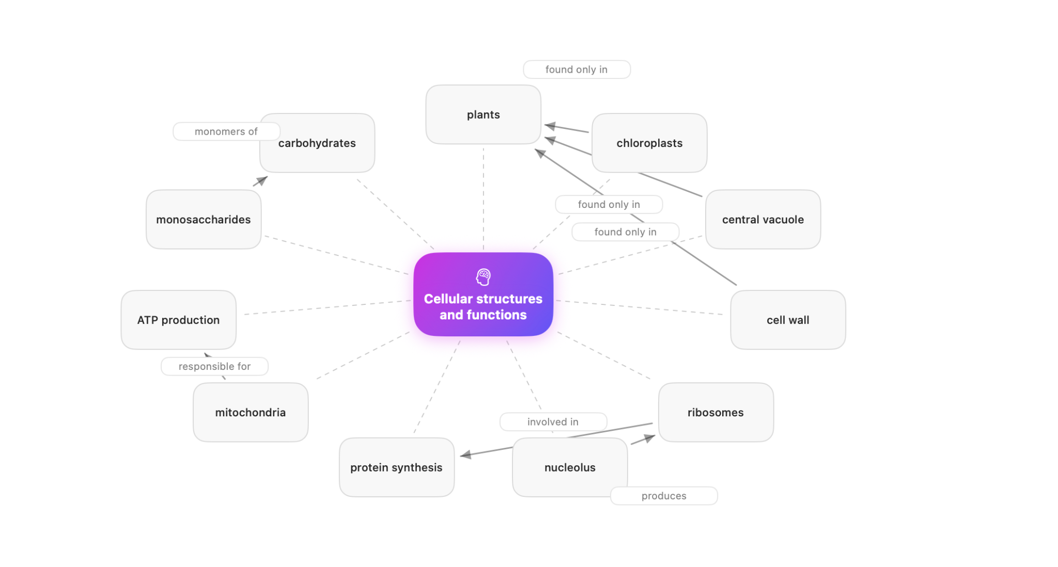
StudyLens
AI study companion for captured notes
Turns scans, handwriting, voice, typed notes, and imported files into study guides, quizzes, flashcards, and concept maps.
CSC 395 Advanced Swift App Development
Michael Amoo
Capture → Learn → Practice → Review

Slide 2
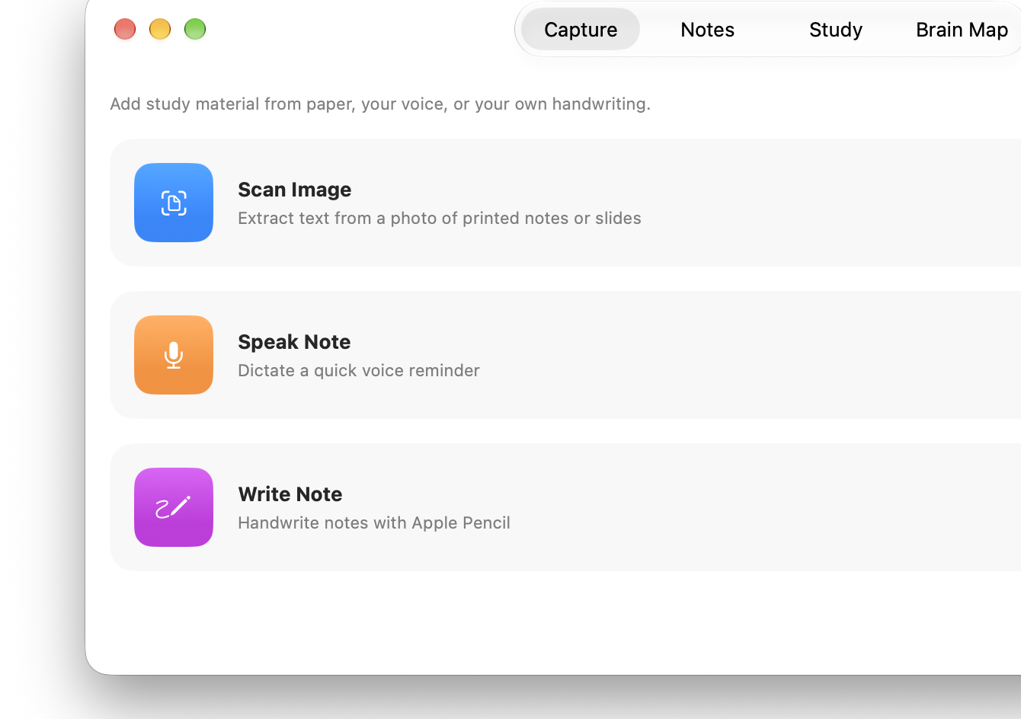
OVERVIEW
StudyLens
One workflow for turning rough material into practice
The app starts with real student material: paper notes, handwriting, voice, typed notes, or files. From there, StudyLens saves a clean note and builds study material from the selected source.
1
→
2
→
3
→
4
Capture
Save Notes
Generate Guide
Study
• One app instead of separate scanner, notes, flashcards, and quiz tools
• Study source can be all notes, selected notes, or one note
• Navigation keeps each tab stable without duplicated screens
Built with SwiftUI, SwiftData, Vision, PencilKit, Speech, PDFKit, Foundation Models

Slide 3
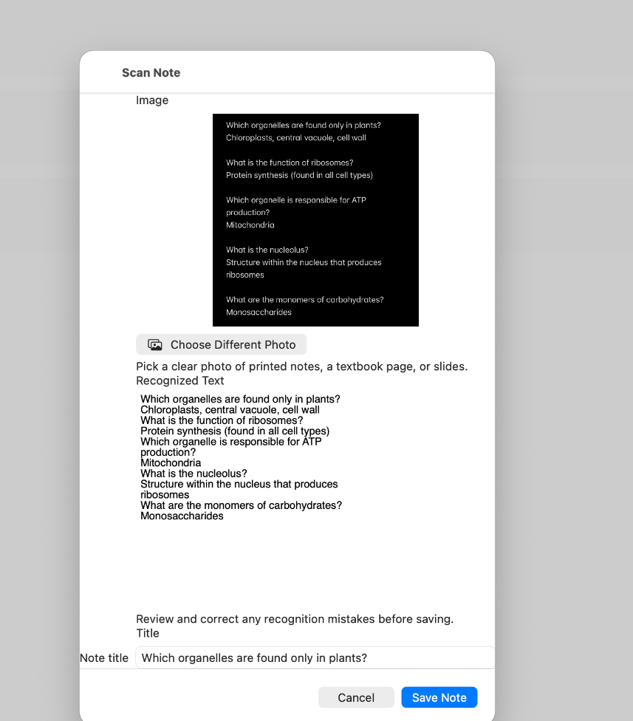
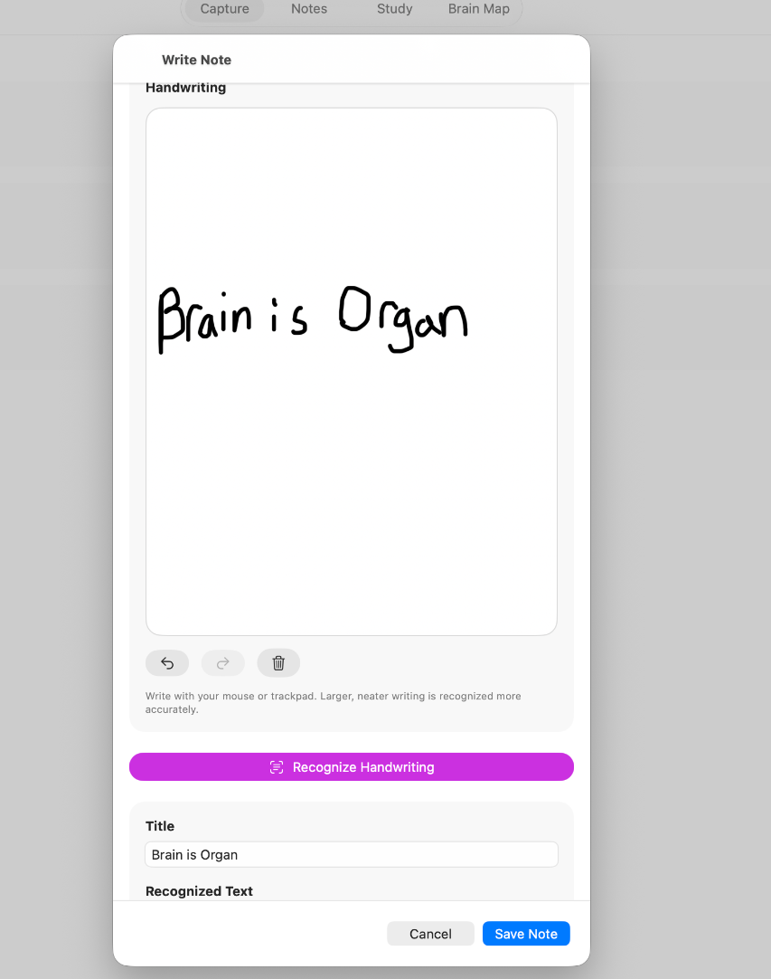
INPUT LAYER
StudyLens
Capture and notes: multiple inputs, one saved study source
Capture options
• Vision OCR for image scans and image-only PDFs
• PencilKit handwriting recognition
• Speech dictation and typed notes
• TXT, Markdown, CSV, DOCX, PPTX, XLSX, and PDF import
Saved notes keep source metadata, import details, and edits through SwiftData, so later study guides can detect when source material changed.
Key frameworks: SwiftData, Vision, PencilKit, Speech, PDFKit, Compression, UniformTypeIdentifiers

Slide 4
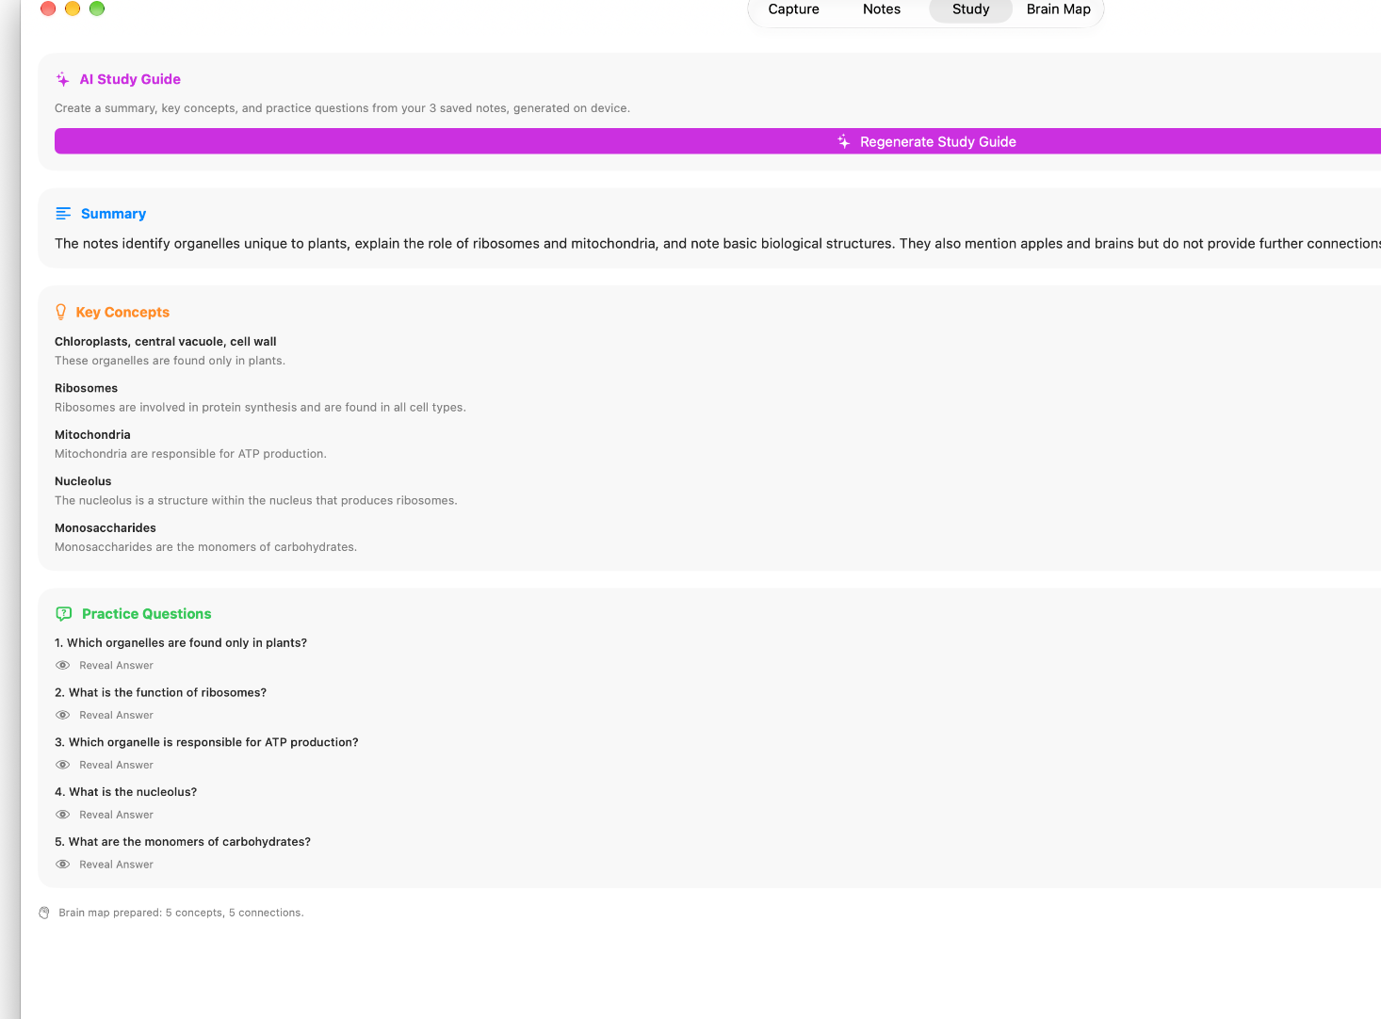
GENERATION LAYER
StudyLens
Foundation Models turns notes into a structured study guide
Generated sections
Summary
Key Concepts
Practice Questions
Brain Map
The model receives only the notes selected in the source picker.
The prompt asks for concise study material and refuses to invent details outside the notes.
Outdated guides show a warning after a source note changes.
3
6K
source modes
prompt budget
The guide is reused by Study, Quiz Me, Flashcards, and Brain Map

Slide 5
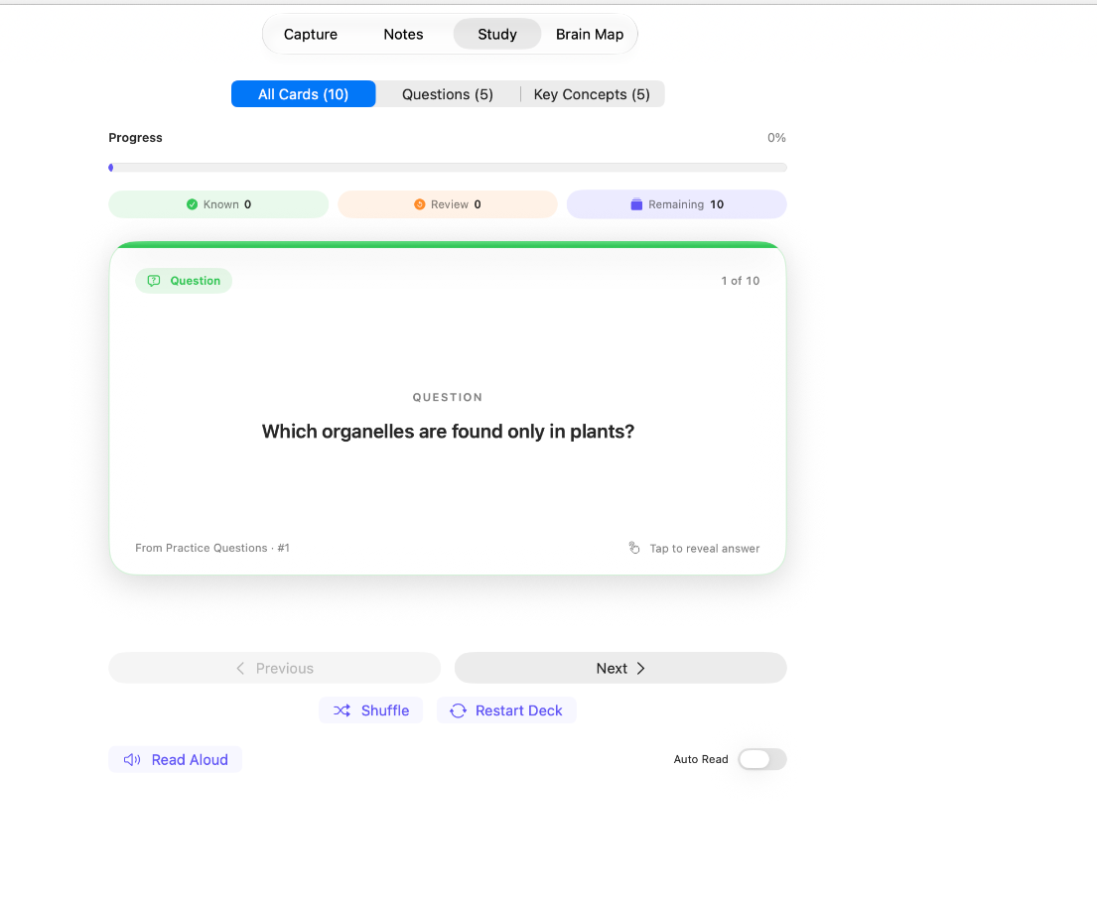
PRACTICE LAYER
StudyLens
Study tools give the guide several ways to practice
Flashcards
• Question cards and key-concept cards
• Flip animation with Reduce Motion support
• Know It / Review Again ratings
• Shuffle, restart, read aloud, and auto-read
Quiz Me
• Speak or type answers
• On-device grading when available
• Local fallback for short answers
• Correct, Partially Correct, and Try Again feedback
Flashcards and Quiz Me use the same generated guide, but track their own session state

Slide 6
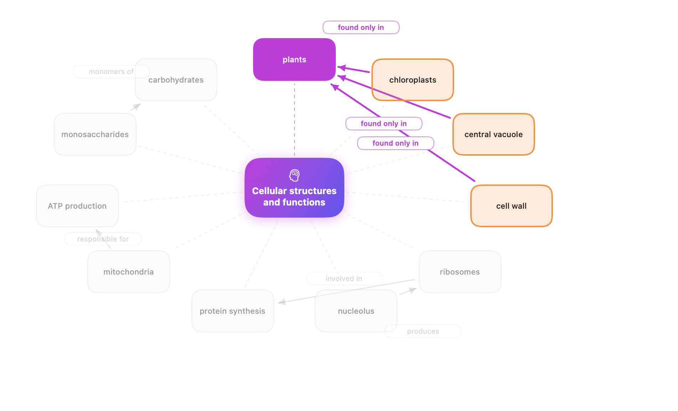
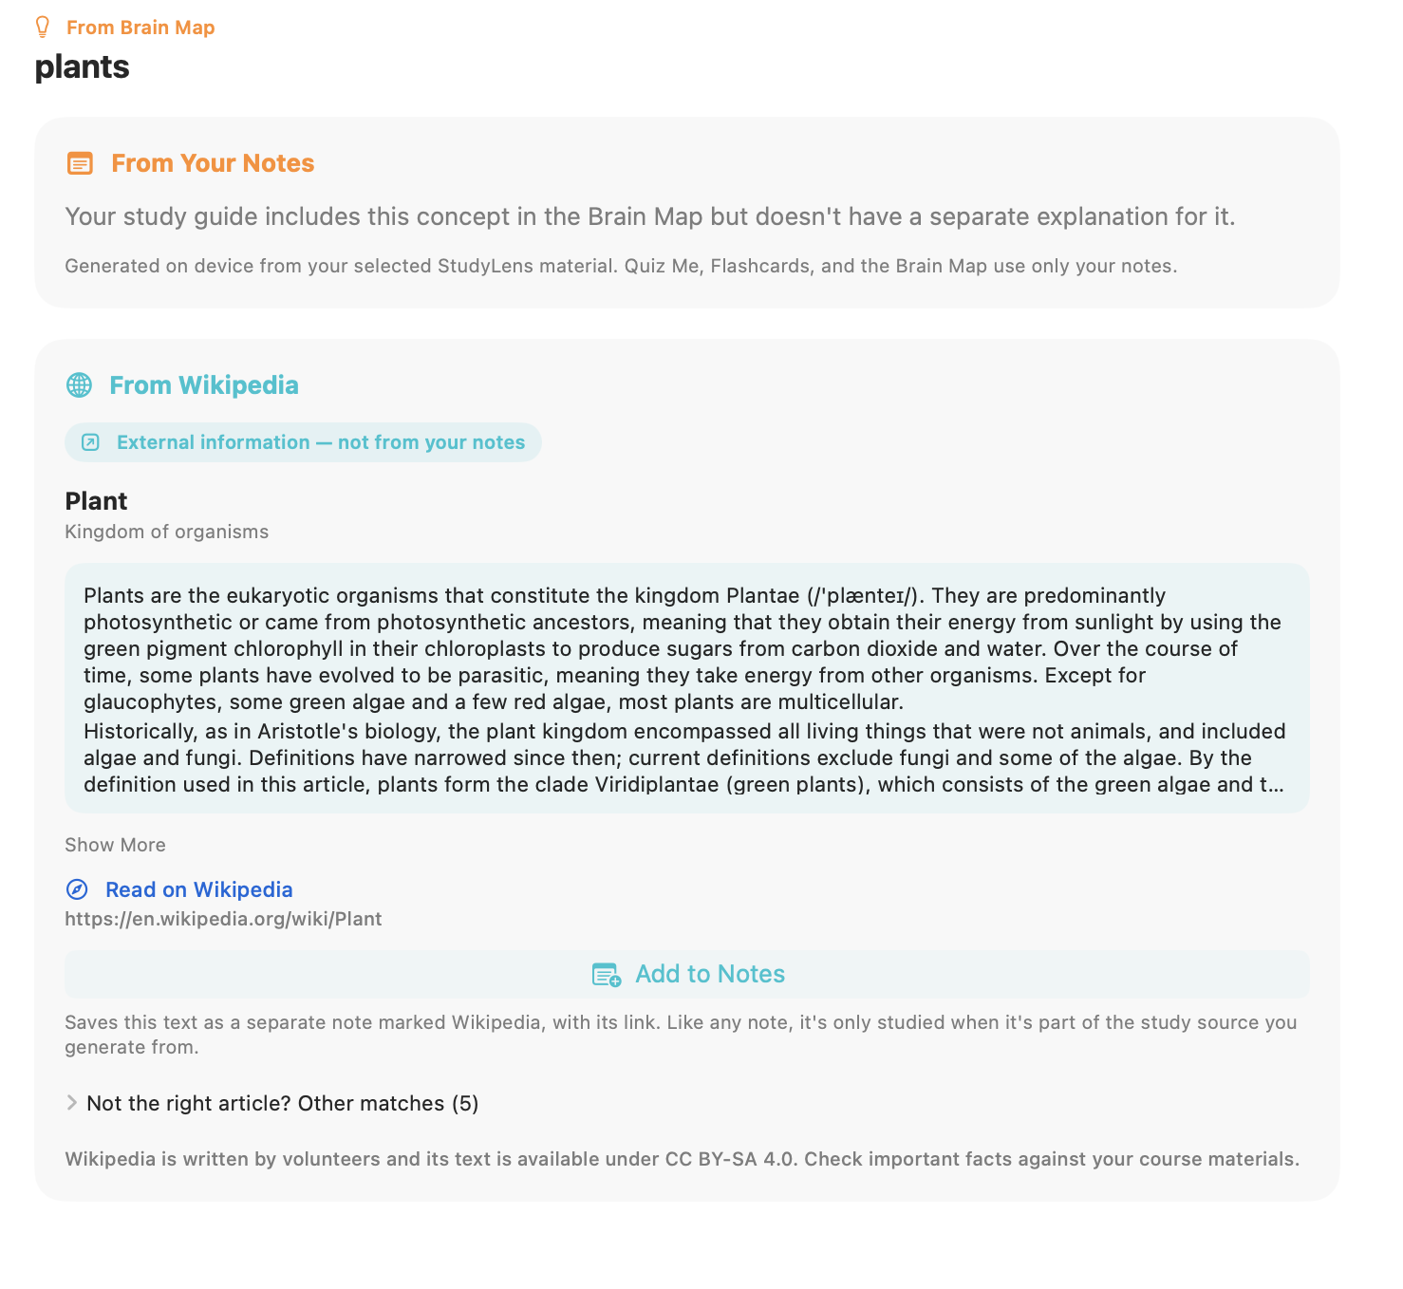
CONCEPT LAYER
StudyLens
Brain Map and Learn More connect concepts without changing notes
Brain Map
• Converts generated concepts into a radial graph
• Nodes can open concept details
• Labels stay inside the map after final layout fixes
Wikipedia enrichment
• Learn More searches English Wikipedia only when tapped
• Results are cached for the session
• Add to Notes saves attribution and prevents duplicates
External info never reaches the study guide unless saved as a note
Built with SwiftUI, SwiftData, Vision, PencilKit, Speech, PDFKit, Foundation Models

Slide 7
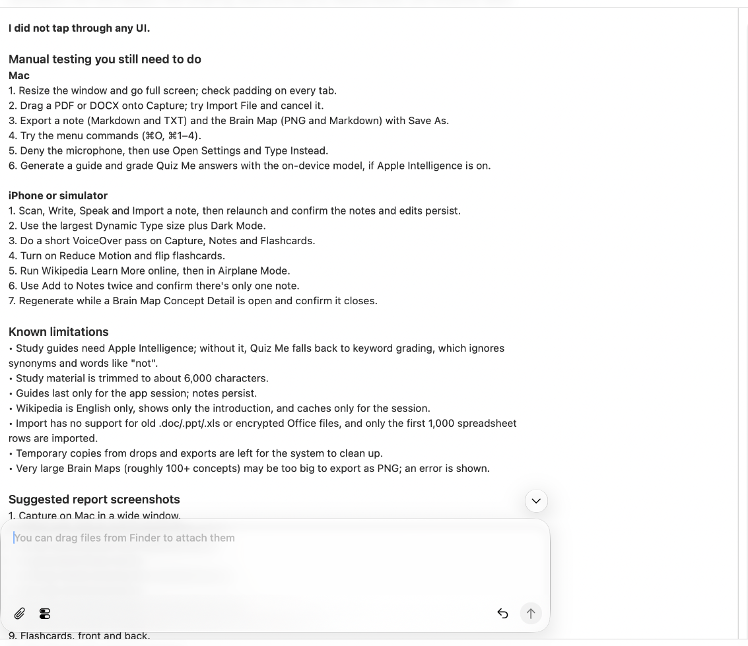
StudyLens
Final audit: stable build, documented agentic workflow
Final result
102/102
0
13
logic checks passed
build errors
bugs fixed
What was stabilized
• Navigation ownership and stale-screen cleanup
• Quiz spinner, short-answer grading, and microphone paths
• Import crashes and Office file edge cases
• Brain Map layout and label clipping
• Export metadata and source attribution
Mac and iPhone simulator builds passed with 0 errors and 0 warnings

